Slide 1
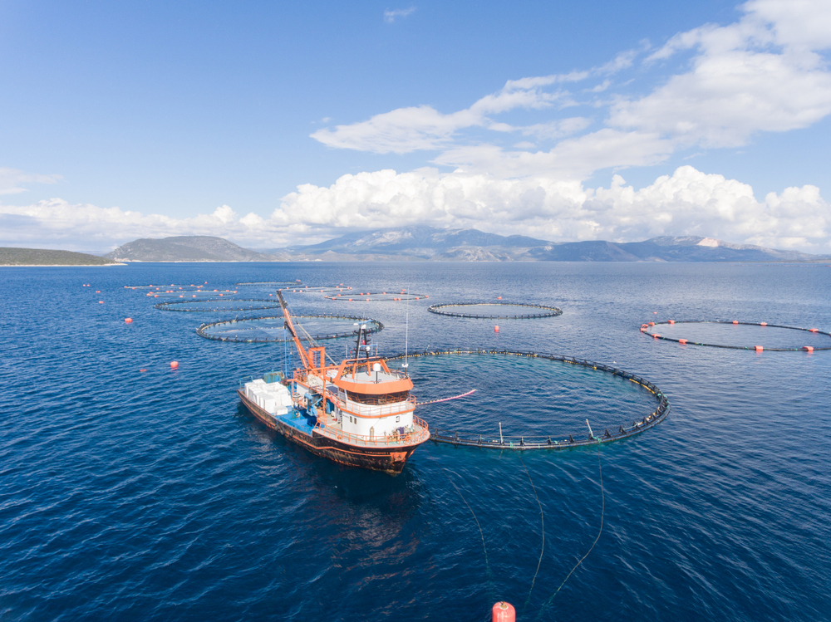
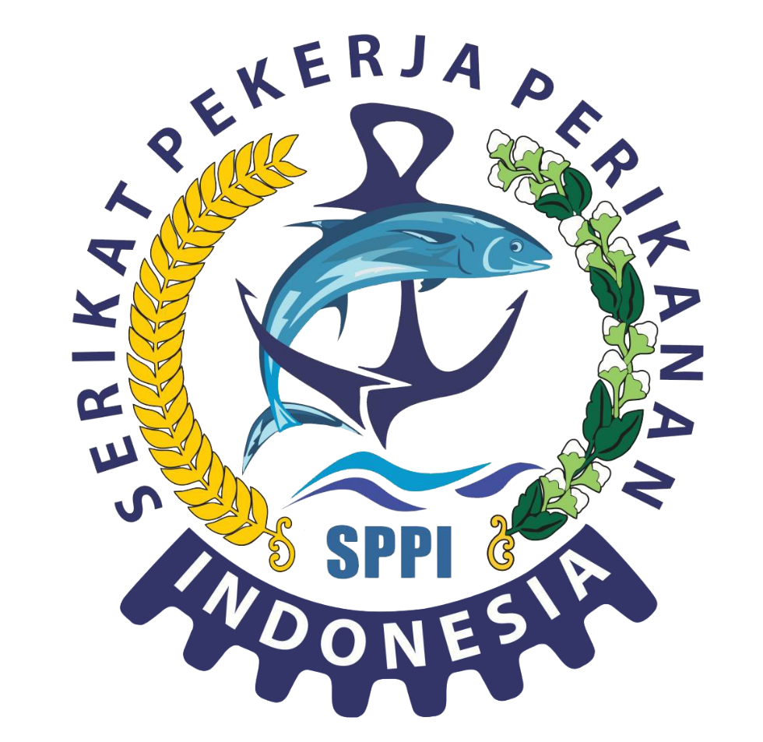
THE ROLE OF TRADE UNIONS IN FULLFILING THE WORKERS’RIGHTS IN FISHERIES SECTOR AND SUSTAINABLE DEVELOPMENT IN FISHERIES SECTOR

Slide 2
FOUNDATIONS
International Maritime Labour Convention, ILO 2006, and its implementation in fisheries sector.
Guidelines on workers’ rights in fisheries sector, including proper wages, normal working hours, safe working conditions, and other normative rights.
Best practices of trade unions in advancing workers’ rights in fisheries sector from other countries.
Training materials on safeguarding the migrant workers in fisheries sector.
Research reports on impact of climate change to sustainability and working conditions in fisheries sector, and strategy to mitigate it.
Practical guidelines on workers’ engagement in decision making on sustainability of fisheries sector.
Analysis on best practices in sustainable resource management in fisheries sector and its impact on working conditions.
Guidelines on developing and strengthening trade unions in fisheries sector, including advocacy strategy and engagement of its members.
Materials on sustainable certification in fisheries sector and the role trade unions to ensure its compliance.
Reports on international and national action plans in improving the workers’ rights and sustainability of fisheries sector, and collaborative efforts of trade unions, government, manning agencies, and civil society organizations.

Slide 3
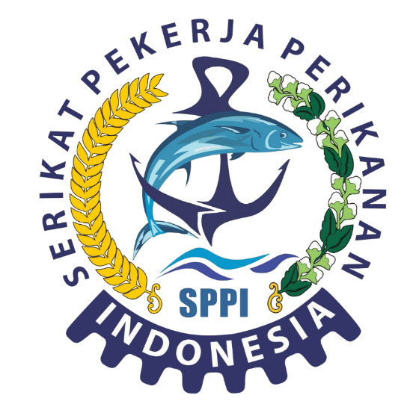

WHO IS INDONESIAN FISHERIES WORKERS UNION (SPPI):
Indonesian Fisheries Workers Union or SPPI was established on 2013, to represent the concerns of workers in fisheries sector, to protect, defend their rights and welfare.
Central office of SPPI at Tangerang District; Branch office in Central Java: Pemalang and Tegal; Branch office: Cirebon, Indramayu; Branch office North Sumatra, West Nusa Tenggara, international representation in Taiwan and South Korea.
Networking with other concerned parties in advancing better conditions of workers in fisheries sector and sustainability of fisheries industry (decent work & economic growth – SDG No.8)
SPPI also advocating the ratification of ILO’s Convention 188 – still in road map status in Indonesia.

Slide 4
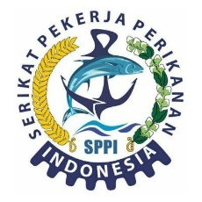
INDONESIAN POLICIES ON GOVERNANCE OF PLACEMENT & RIGHTS OF FISHERIES WORKERS
INDONESIAN REGULATIONS:
Law No. 18/2017 on protection of Indonesian migrant workers;
Law No. 17/2018 on shipping;
Law No. 6/2016 on ratification of International Convention on the Protection of the Rights of All Migrant Workers and Members of their Families;
Government Regulation No. 22/2022 on Employment and Protection of Merchant Ship Crew and Migrant Fishing Boat Crew;
Government Regulation No. 20/2010 on Water Transportations;
Ministry of Transportation Regulation No. 84/2013 on Recruitment and Employment of Ship’s Crew;
Ministry of Transportation Regulation No. 59/2021 on Implementing the Business Services to Transportations on Water.

Slide 5
INTERNATIONAL INSTRUMENTS:
Convention on International of the Sea (UNCLOS) 1982, as foundation for regulating sea based on zoning consists of maritime zones on (i) national jurisdictions, and (ii) outside of national jurisdictions;
Convention of ILO No. 188 as one of the major convention on migrant workers in fisheries sector;
International Maritime Labour Convention (MLC) 2006: as major instrument in regulating minimum standard protection of workers in maritime sector, including fishing boat crew. Indonesia is one the party in MLC 2006, which provide basis for normative rights of ship’s crew, i.e. proper working conditions, safe conditions, and access to health services.
General Principles and ILO’s Operational Guidelines on Just Recruitments as non-binding general principles and operational guidelines.
International Convention on Protecting All Migrant Workers and Its Families. This convention is a comprehensive international agreement focus on protecting the migrant workers’ rights and its families;
Global Compact Migration (GCM) is the first agreement negotiated among governments under United Nations, covering all dimensions of international migrant workers holistically and comprehensively.

Slide 6



Problems of Fisheries Workers in Taiwan
Wages cut
Long working hours
Confiscation of documents

Slide 7


Sustainable Development Goals
Promote peaceful and inclusive societies for sustainable development, provide access to justice for all and build effective, accountable and inclusive institutions at all levels
Promote Sustained, Inclusive
And Sustained Economic Growth, full and productive employment and decent work for all

Slide 8
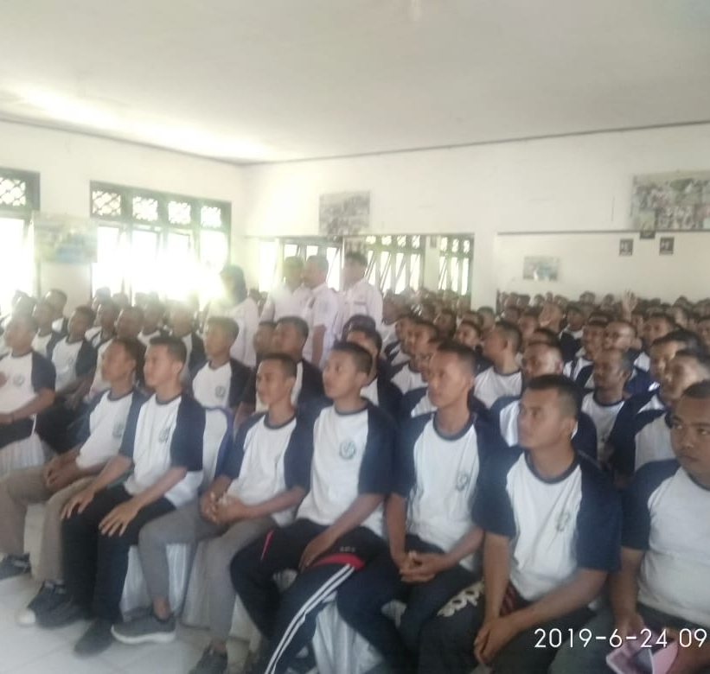
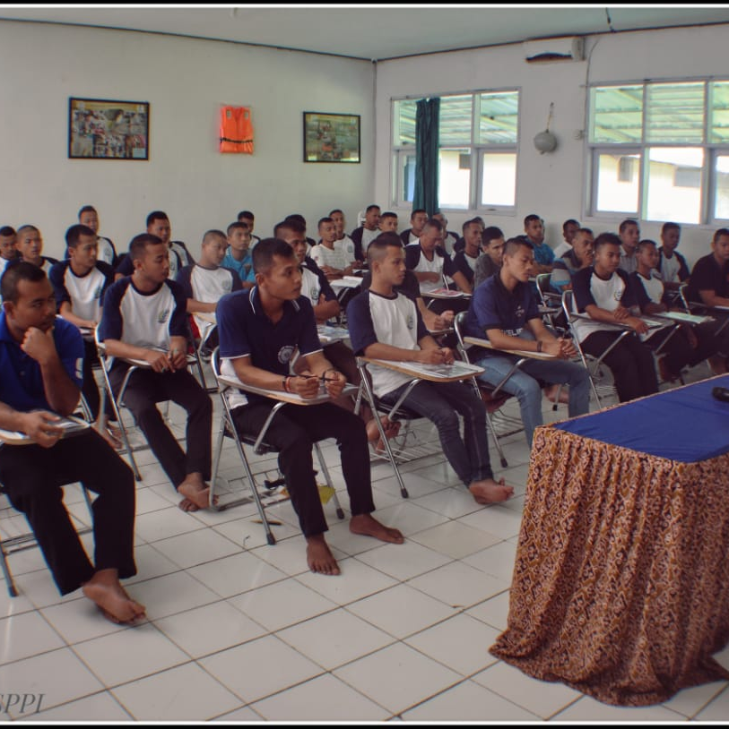
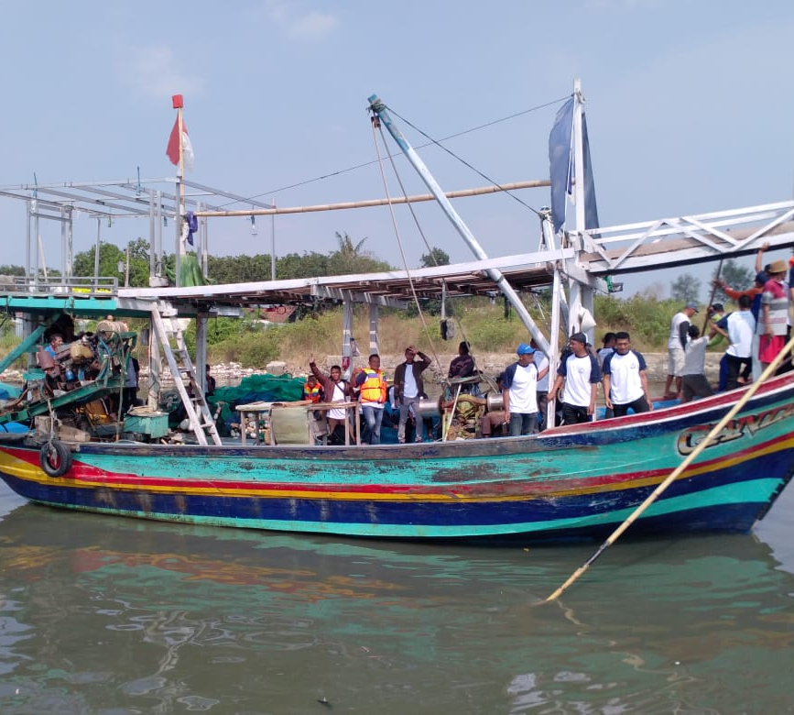

The role of trade union (SPPI) in protecting the rights of its members and promoting members welfare
Prevention program: developing accredited training-centre, provision of pre-departure orientation program, generate web-based data base of the members and web-based complaint handling mechanism to enable real time assistance.

Slide 9
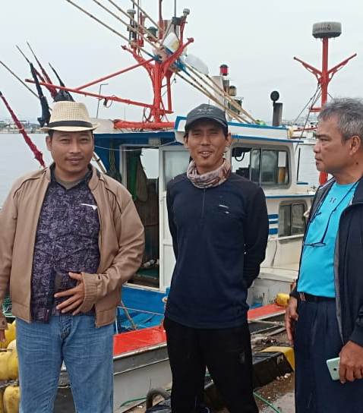
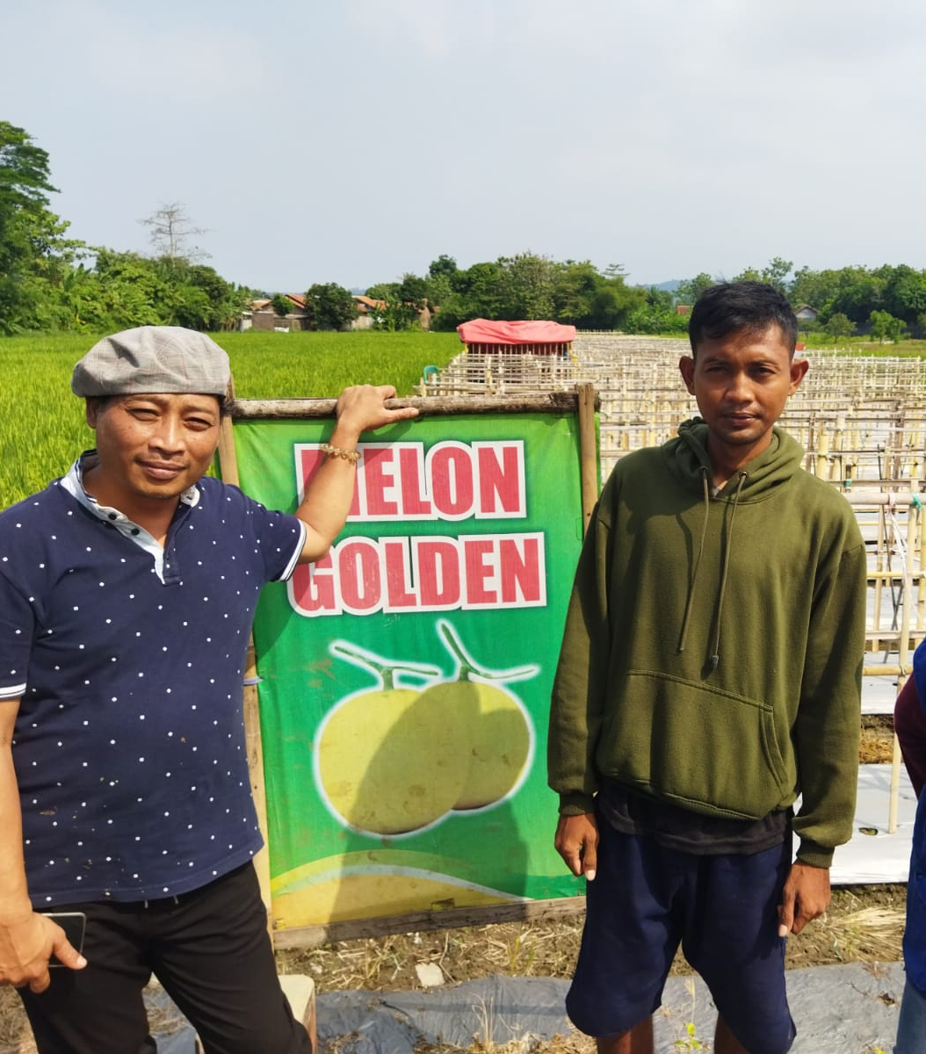
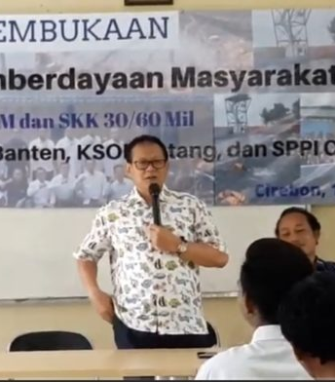
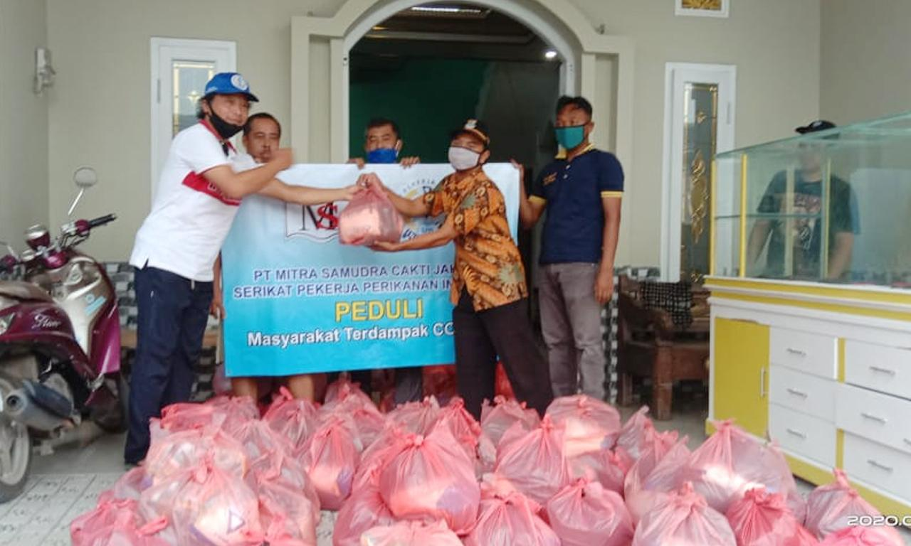
Protecting the rights of the member of trade union: provision of assistance to members facing working problem right from recruitment, during employment, and after employment, empowerment of member of trade unions, training on financial literacy, promote enterpreunerships among the trade union members (entrepreuner incubation), promote transparency among all stakeholders in protecting the workers’ rigthts and creating sustainable ecosystem in fishery industries

Slide 10
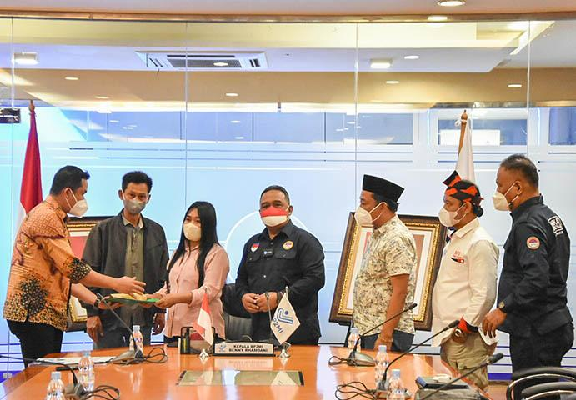
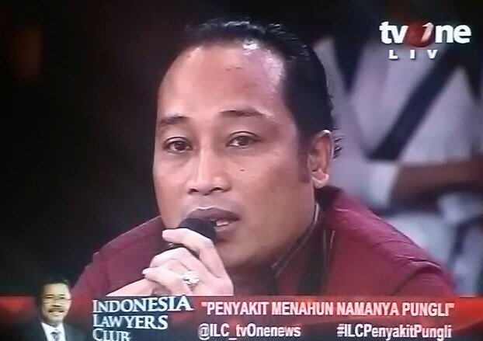
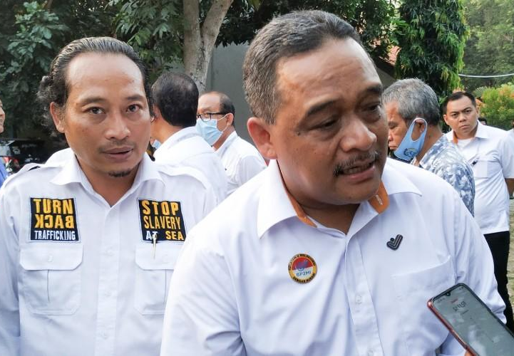
Advocating Policy to protect the Indonesian Fisheries Workers, provides critical inputs to related Ministries and other related agencies concerning governance and workers protection.

Slide 11
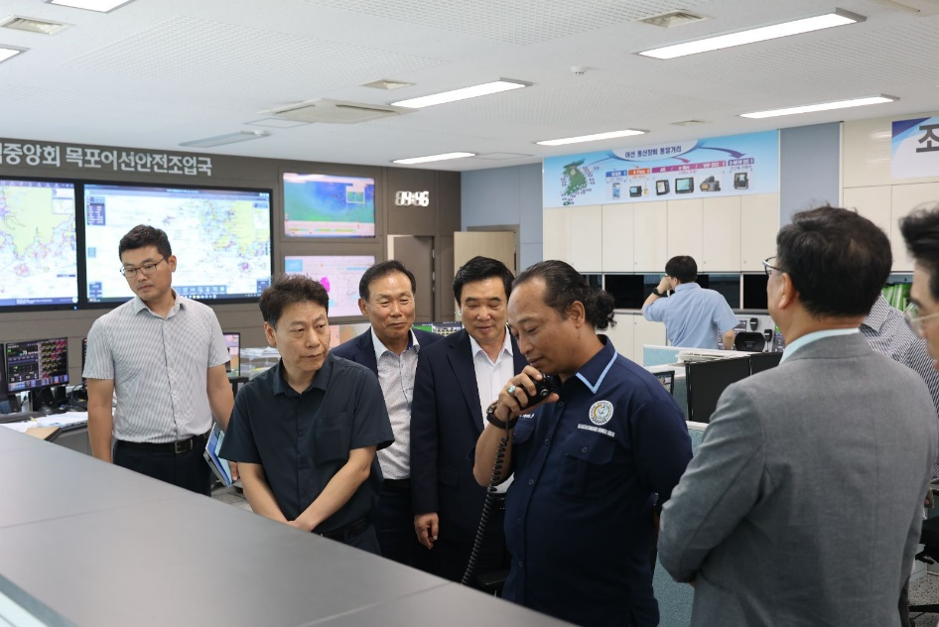
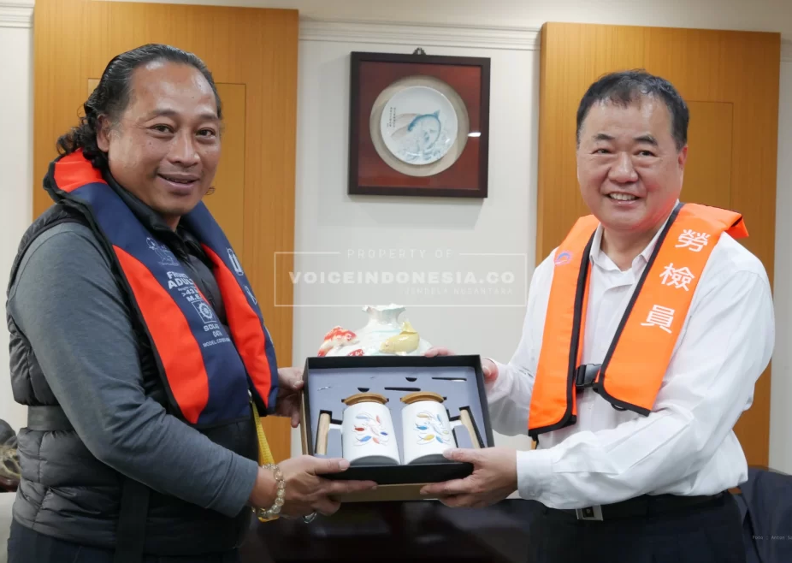
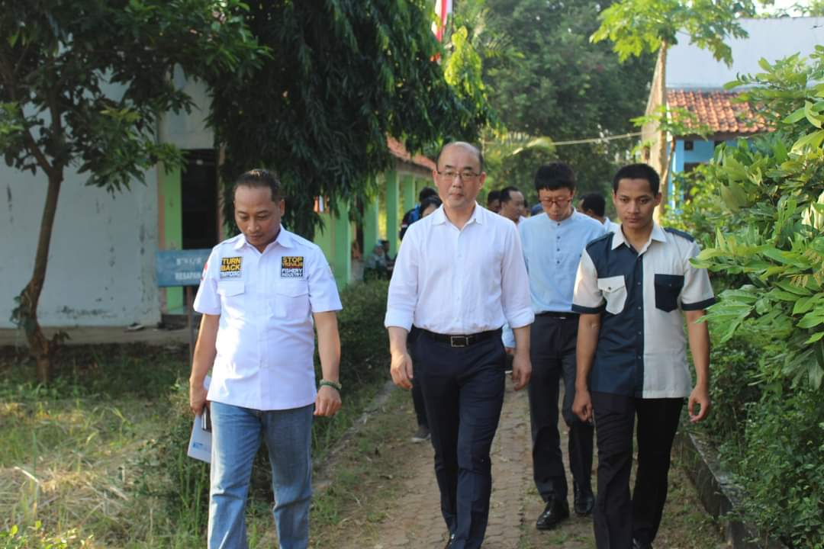
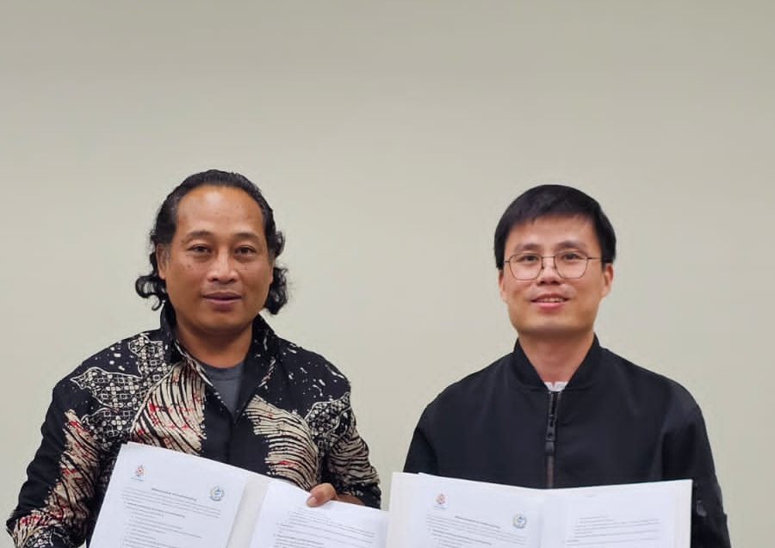
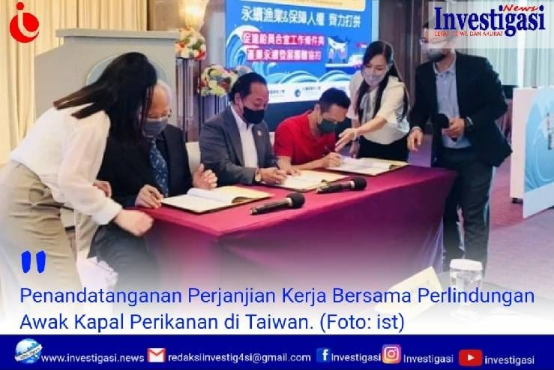
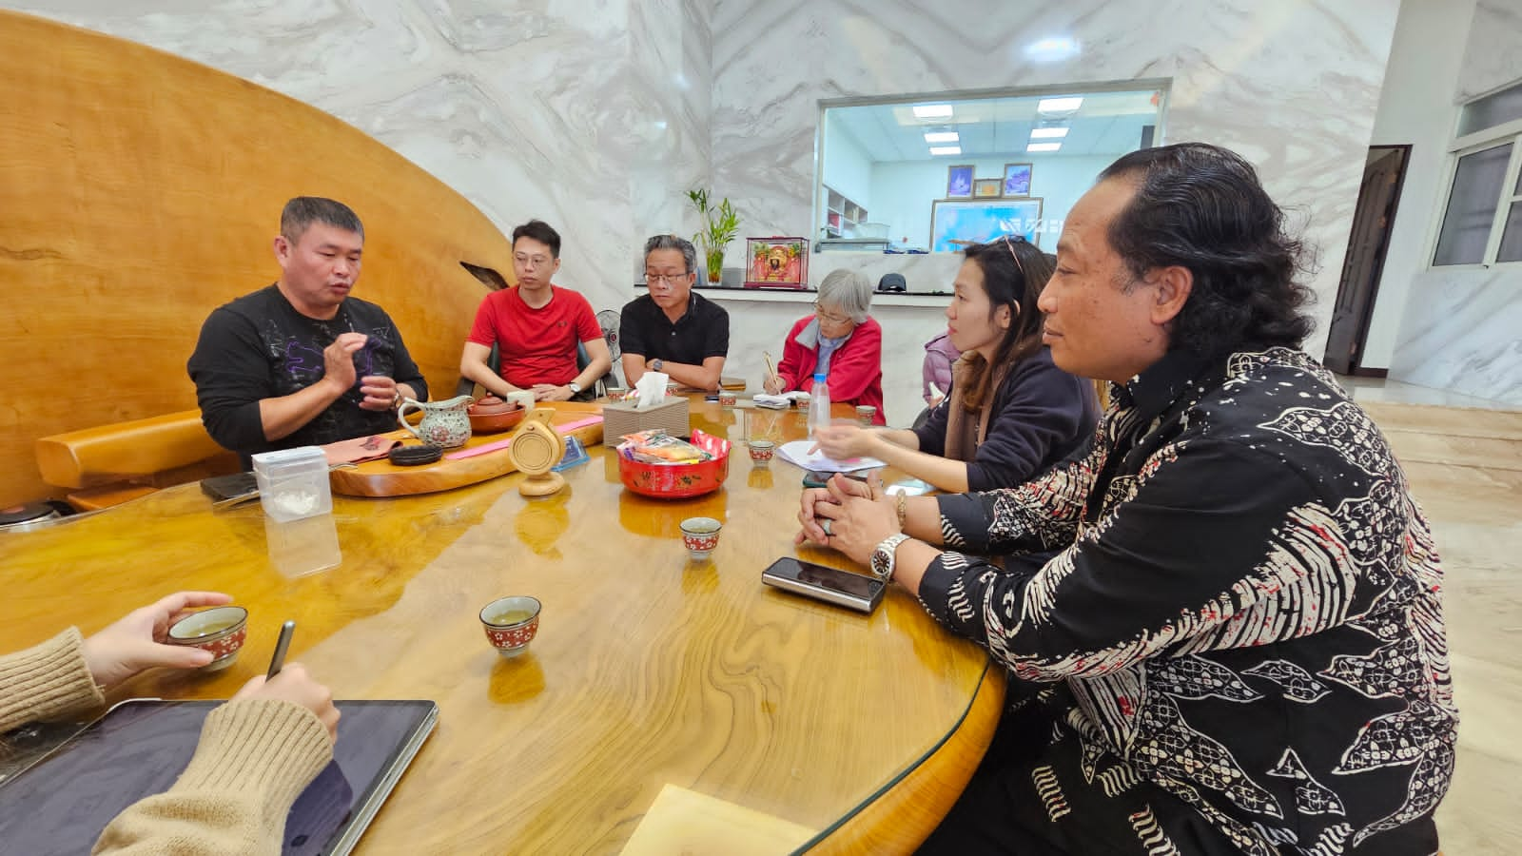
Collaborative efforts: engage collective bargaining agreements (CBAs) with 47 Manning Agencies; tripartite cooperation trade unions-Manning Agencies Association-district manpower offfices; Civil Society Organizations and Law firm in South Korea; CSOs in Taiwan; concerned scholars/intellectuals in Taiwan, embark upon agreement with 2 associations in Taiwan

Slide 12
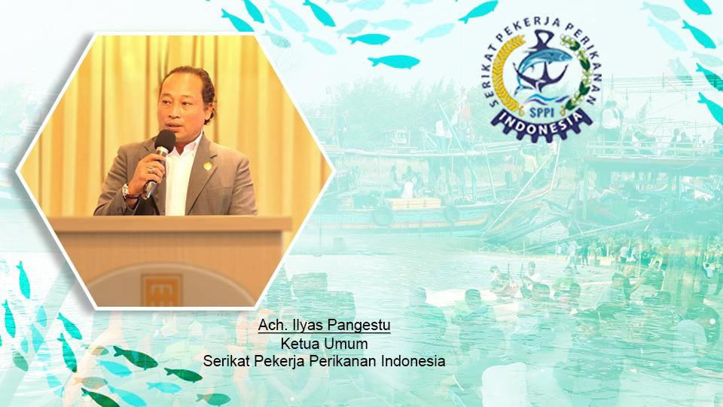
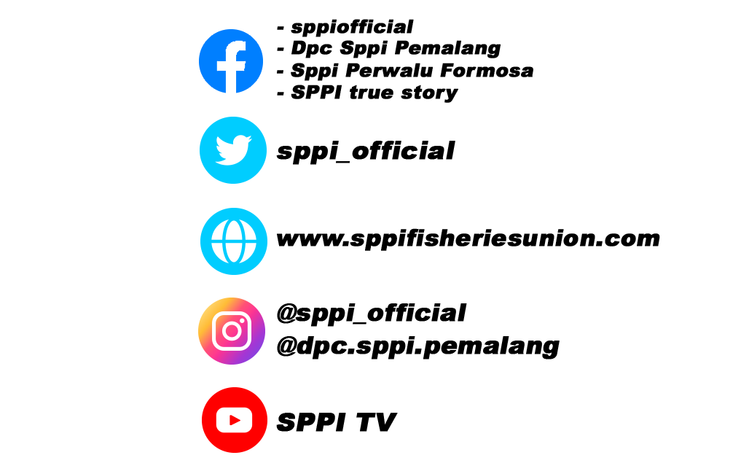
“We are only visitors in this world,
therefore do not exploit it.”

