Slide 1
ILO C188 & Occupational Safety and Health and Medical Care
ITF point of view

Slide 2
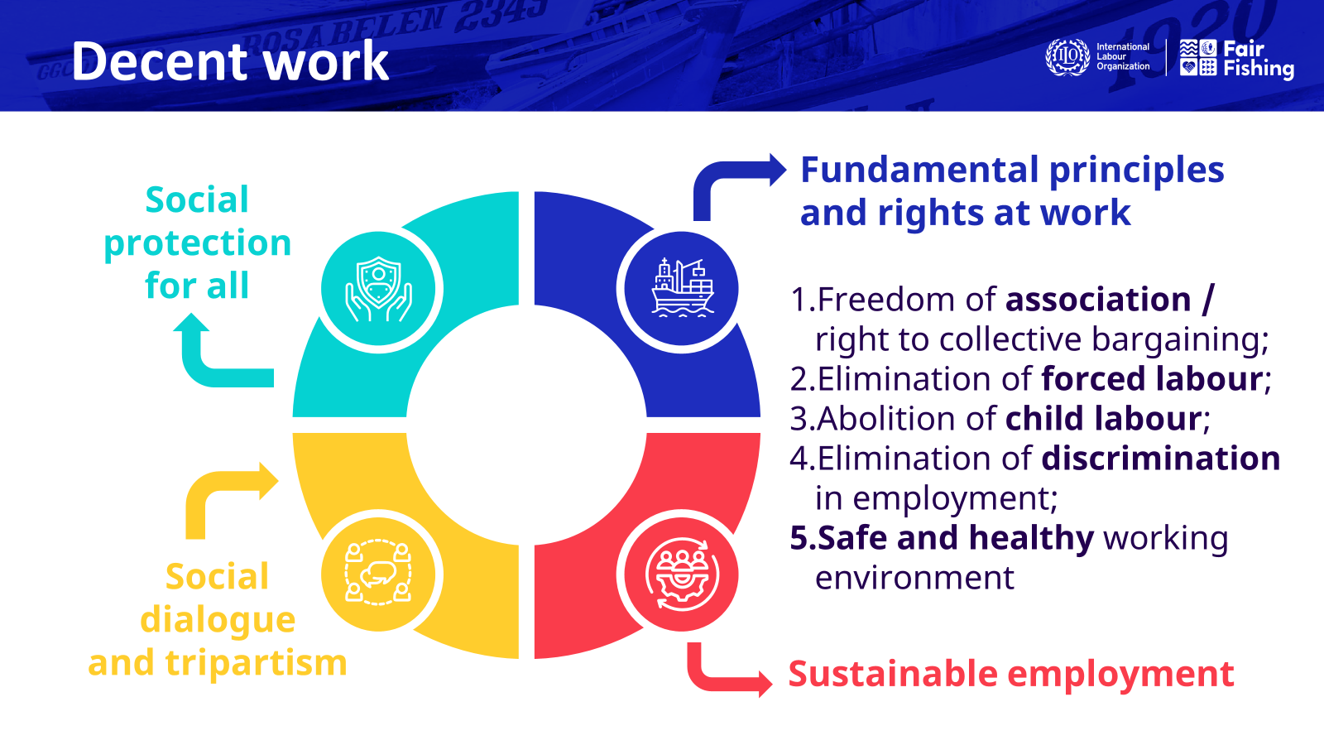

Slide 3
Occupational Safety and Health
A safe and healthy working environment is a fundamental principle and right at work. The ILO added this as its fifth principle in 2022. This means occupational safety and health can no longer be considered an optional extra.
The principles concerning the fundamental right to a safe and healthy environment are the subject of the Occupational Safety and Health Convention, 1981 (No. 155) and the Promotional Framework for Occupational Safety and Health Convention, 2006 (No. 187), which are now considered as fundamental Conventions. They contain provisions of general scope covering all branches of activity and all workers, regardless of the type of hazard, and they serve as the basis for the safety and health measures provided in other specific ILO instruments. Bearing in mind the often-hazardous nature of work in fishing, special consideration is needed for the safety and health of those who work on board fishing vessels, including with regard to ensuring that they are medically fit for that work.
Fishing is without a doubt one of the most hazardous occupations in the world and has been formally designated as a hazardous industry by the ILO. Many thousands fishers’ lives are lost every year causing great sorrow and often leaving families in financial hardship. There is clear evidence that the nature of fishing operations is a significant cause of many of the injuries and accidents affecting fishers.

Slide 4
Safety culture
The development of a safety culture amongst fishers should be a priority for all those involved in the fishing industry. A safety culture is something that cannot be created through regulation alone and will require the adoption of a holistic approach to all aspects, including social and labour conditions. It will also require zero tolerance of dangerous practices and recognition that most accidents can and should be prevented.
Fishing vessels should be designed and equipped in a manner, which prevents, as far as possible, traditional occupational diseases and accidents among fishers. In addition to the adoption of appropriate technical standards for the fishing industry and requirements for the use of various types of fishing gear and procedures on-board (e.g., working patterns), there is also a need to address the human element and how it contributes to accidents.
One of the major causal factors in accidents on board fishing vessels is fatigue. It is therefore essential that regulations addressing working hours and rest periods are established and strictly enforced. Crewing levels on board fishing vessels should be established at the national level to ensure the safe navigation and operation of the vessel taking into account the area of operation and type of fisheries.

Slide 5
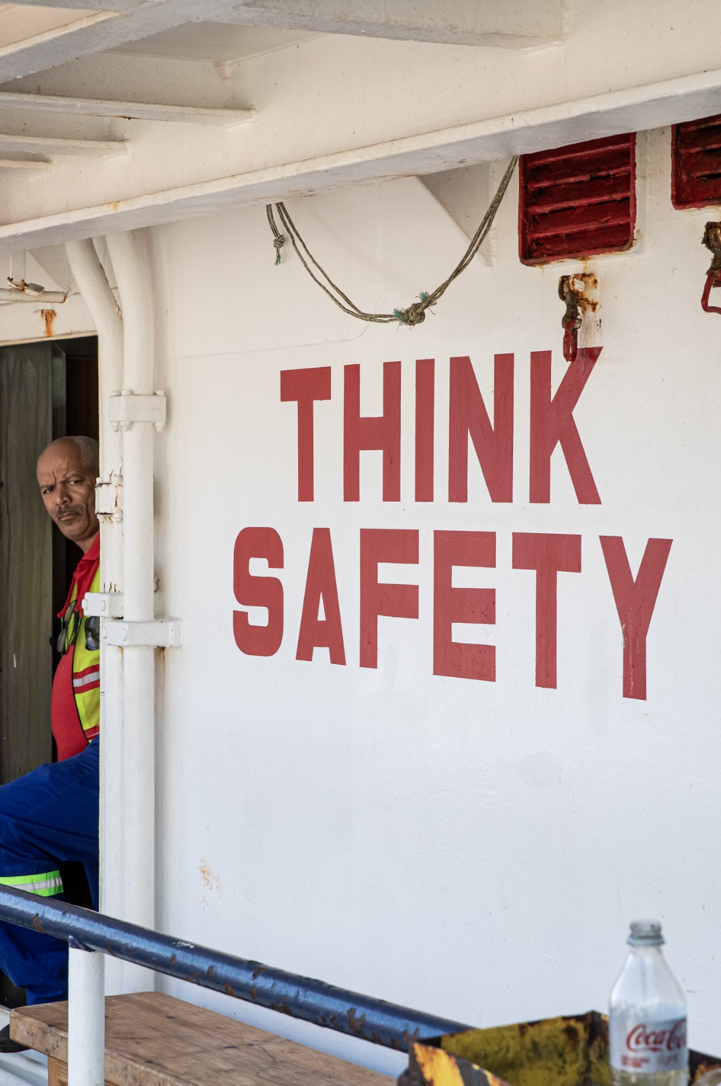


On board: Occupational safety and health (OSH)
    To ensure prevention occupational accidents, diseases and work-related risks:
    Personal protective equipment
    Risk evaluation to be conducted
    Training (fishing gear, basic safety, familiarization)
    Reporting & investigation of accidents
    Special consideration for fishers under 18 years old
    Setting up of joint OSH committees
    Higher requirements for larger vessels at sea for over 3 days
South African flagged vessel, Cape Town 2022
Notes:
Higher requirements for vessels = or > 24m normally remaining at sea for more than 3 days.

Slide 6
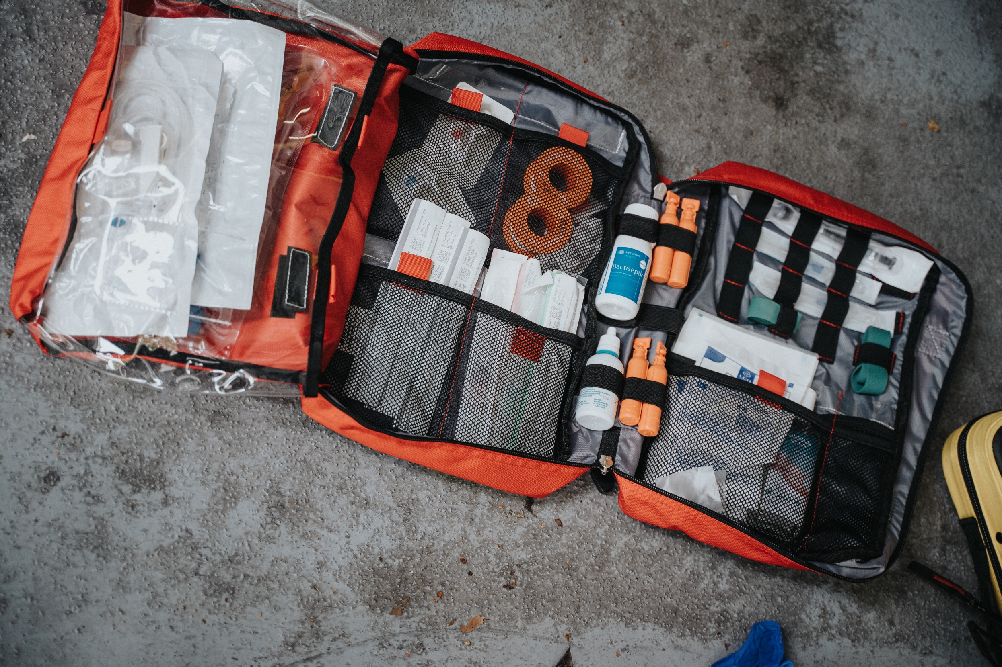
On board: Medical care and social security
    Medical care
      Vessels must carry appropriate medical equipment and supplies
      At least one fisher on board trained in first aid
      Vessels to be equipped with radio or satellite communication
      Right of fishers to medical care on board
      Right to medical treatment ashore if seriously sick/injured
    Social security
      Fishers entitled to social security benefits
      no less favourable than other workers
    Protection in the case of work-related sickness, injury or death
      Fishers must have access to appropriate medical care and compensation
Notes:
Medical care: higher requirements for ships = or >24m. Social security: based on the criterion of ordinarily residence in the territory of the ratifying Member, regardless of nationality and flag of the vessel. Progressive comprehensive protection for fishers. Bilateral and multilateral agreements.

Slide 7
ITF Fisheries Occupational Safety and Health Policy
The objective of this policy is to provide practical guidance to ITF fisheries affiliates, on safety and health on board fishing vessels with a view to:
Create a safety culture throughout the fishing industry;
Prevent accidents, diseases and other harmful health impacts on the health of fishers arising from employment on board fishing vessels;
Ensure that responsibility for safety and health is a priority for all, including governments, fishing vessel owners, fishers and their representatives;
Promote consultation and cooperation with governments and fisheries employers’ organisations at national, local and company levels to improve safety and health on board fishing vessels;
Secure proper representation of fishers to improve safety and health on board.

Slide 8
IMO-ILO Guidelines for medical examinations
The IMO and ILO adopted Guidelines for medical examinations in February 2024. They apply to fishers in accordance with the requirements of Convention No. 188 and the 1995 STCW-F Convention.
The crew of fishing vessels need to be medically fit for their physically demanding work. New medical examination guidelines will improve and standardize these examinations, leading to improved health and safety in the fishing sector.
In addition to the medical examination guidelines, the tripartite meeting noted the importance of fisher’s occupational health surveillance programmes. They requested the ILO develop guidance on this subject through a tripartite consultation process and with the IMO and others, drawing on principles set out in ILO occupational safety and health instruments, as well as work that is already being undertaken by social partners and maritime medical experts.

Slide 9
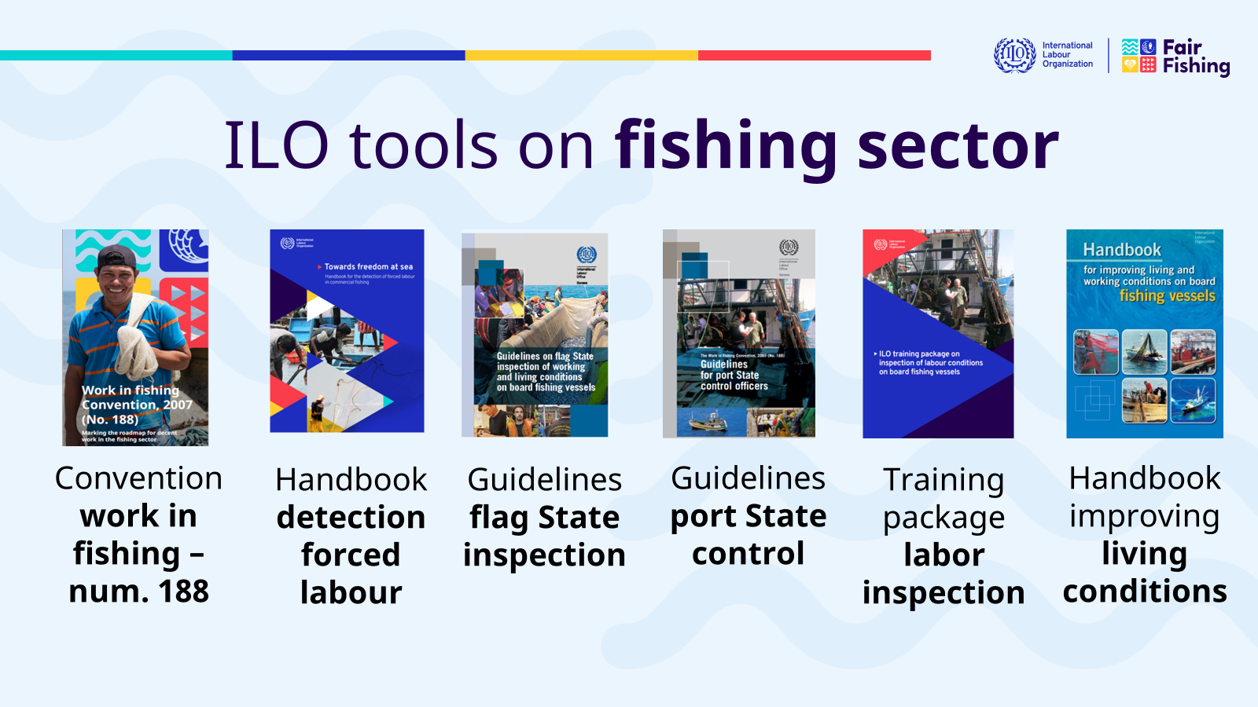

Slide 10
